Slide 1
Fitness Tracker Pro
Yuying Wang, Jing Chang, Zhicheng Zhou
Tianyang Yu, Hanchen Li
Notes:
Hello Everyone we are team 6. My name is Yuying,...

Slide 2
Phase 1 - Creating Fitness Tracker Pro
Problem:
Fitness enthusiasts usually keep their exercise journals every day, but it is hard to record and generate a vivid visualization of the work they achieved. They also want to know about their exercise patterns as well as sport suggestions. A “Fitness Tracker Pro” application can be created to satisfy all these needs.
Notes:
We create a Java application, Fitness Tracker Pro,
Because some people like taking notes when they are doing exercise in gym,
we create this app for them to store those data. We also have other useful features for them to use.

Slide 3
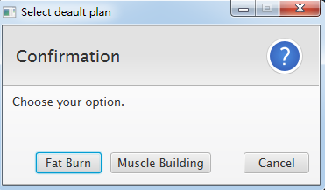
When you first open our application...
Notes:
For example, when you download and first time open this app, you will have option to choose a plan for your workout, either for burning fat and losing weight or building your muscle.

Slide 4
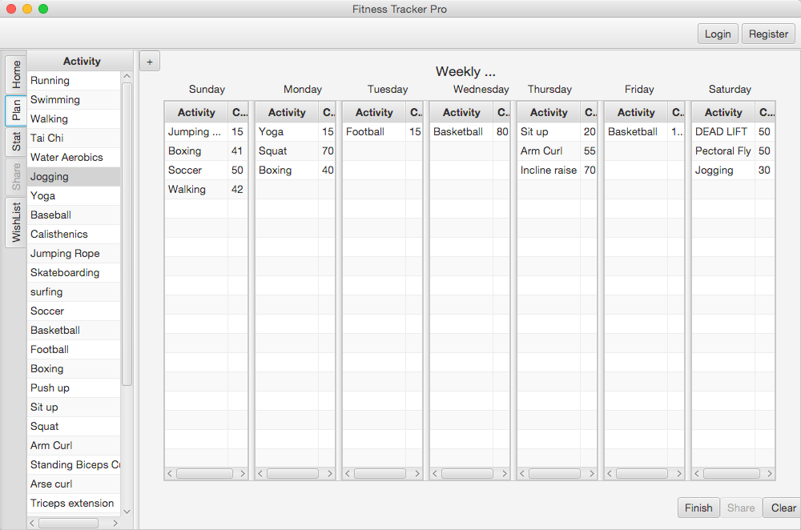
Weekly Plan
Notes:
After you select one, you can see the detailed information about this plan in the plan tab. See on Tuesday, I plan to play football for 15 minutes. You can also edit those activities by dragging them from the list on the left.

Slide 5
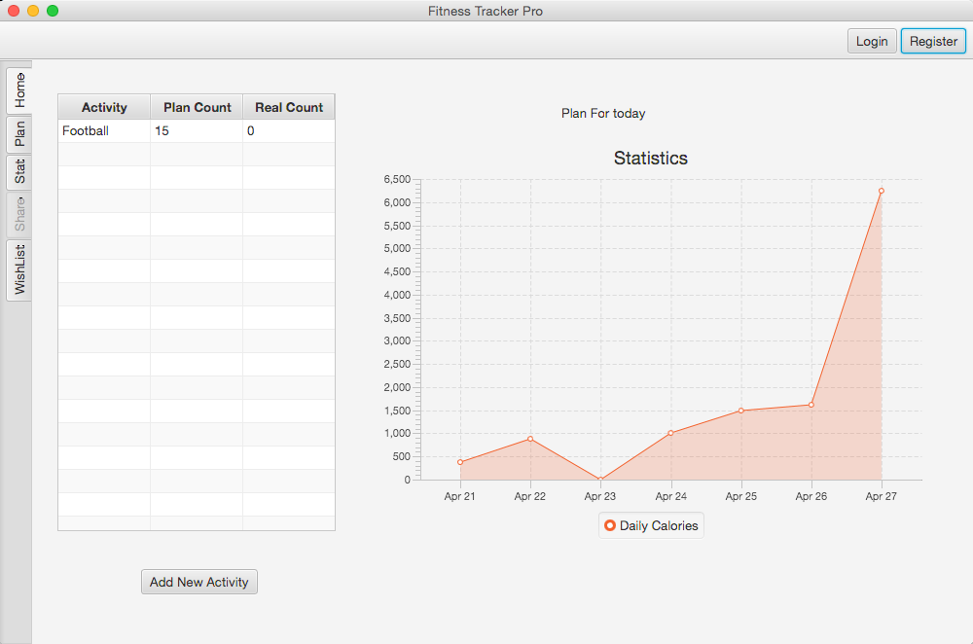
Home Tab
Notes:
And your planned activity for today will be shown on the home tab. For each activity, plan count is how long or how many frequencies you plan to do this activity, and real count is where you input your actual amount. The graph on the right side is for users to view their exercise patterns in the past few days.

Slide 6
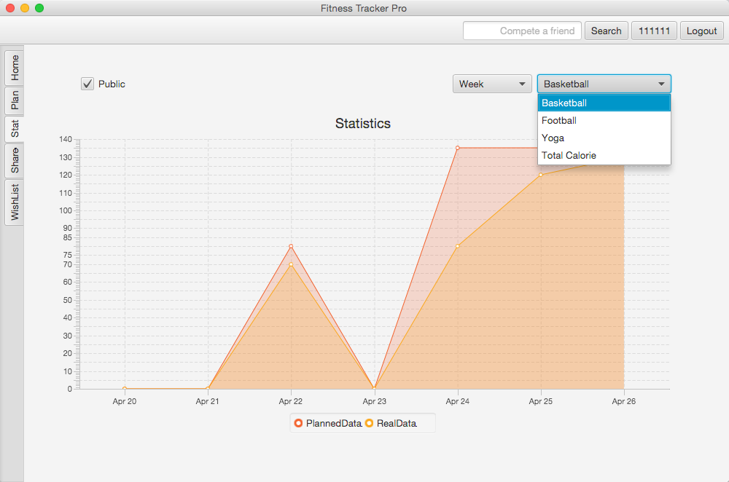
Statistics Tab
Notes:
Here is our statistics tab
In this tab, I can compare my real workout with the quota of my plan
As you can see here I can choose any single activities as well as the total calories to draw the plot. and the time frame can be a day, a week, a month or a year.

Slide 7
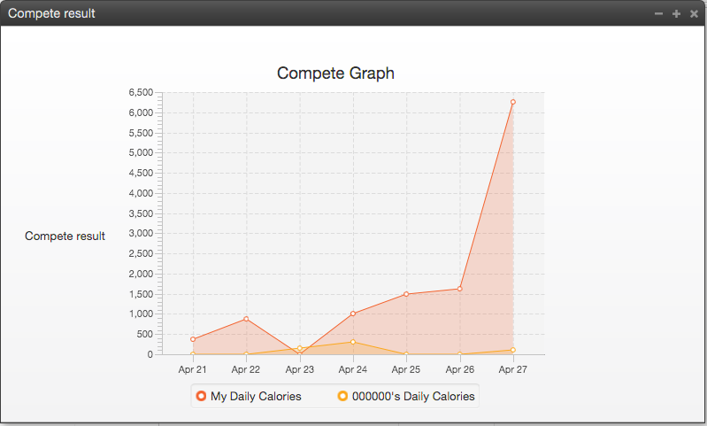
Compete With Another User
Notes:
Not only can you compare workload with your plan, you can also compare it with other members, which is called compete in our program

Slide 8
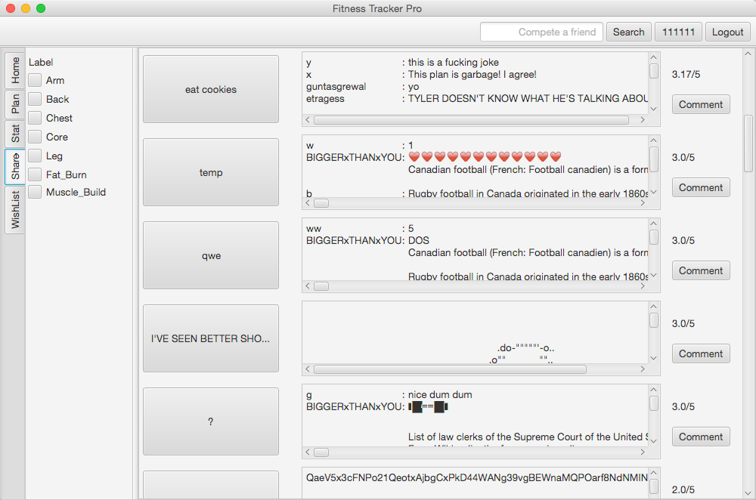
Share Tab
Notes:
This is our share tab. I can search plans that is shared by other user. And I can rate and write comments for the plans here. As you can see these hearts, you can insert emoticon to your comments.

Slide 9
Phase 1 - Testing Fitness Tracker Pro
Worked well?
Code Inspection
Test Plan
Not perfect, but already reveals enough number of defects
Incremental Testing
Bottom-Up approach
Unit Testing
What didn’t work well?
Regression Testing
Design Inspection
Notes:
When we test our own project, we find out the code inspection worked really well for us. We actually find a number of defects during the progress of code inspection, which are not exposed yet during the progress of code inspection.
Our test plan also works pretty good, it actually reveals enough number of bugs. But of course, our test plan is not perfect, some defects that correlate with the implementation details can not be revealed by our test plan. For example, we had a defect that different plans with same plan name can not exist in the wishlist at the same time.
In incremental testing, we use the bottom-up approach, we find it really easy to write driver to test out project incrementally.
And Unit testing also reveals a lot of bugs when we test individual module by each author.
What didn’t work well is Regression Testing. We didn’t find many defects in Regression Testing since the modules in our project are highly independent.
Also, Design Inspection did not work well for us.

Slide 10
Phase 1 - Testing Fitness Tracker Pro
What would we do differently?
Be more efficient in code inspection
Avoid discussing too much details on correction
Update test plan
Modify test plan every time we make a change
Notes:
The first thing we would do differently about testing our own program is being more efficient in code inspection. We often had long code inspections because we discuss too many details about how to fix the bug during the inspection, which took so many time.
And the other thing is updating the test plan every time we make a charge in the backlog. During the develop stage, we change the user interface several times to have a better usability, but we forgot to change the test plan, which leads some defects are not covered by the test plan.

Slide 11
Phase 1 - Testing Fitness Tracker Pro
Strategy for Seeding defects:
Avoid bugs that crash the app
Non trivial bugs (unclickable button)
All bugs should be independent
Based on the bugs that we encountered
Notes:
For seeding 25 defects into our program, we follow these four principles.
The first one is avoiding bugs that can cause the application crash, which is also the requirement of this course.
The second principle is not introducing trivial bugs, like simply disable a button.
Also, we want all bugs we seeded are independent, which means no different defects result a same unexpected behavior of the program.
The last strategy is insert some bugs that we encountered according our defect log.

Slide 12
Phase 2 - Testing StudyBuddy
Testing Process:
Go through documents that describe how to run the projects.
Prepare multiples devices, such as tablets and different version of android phones, run the project, and get to know functionalities of the application.
Write a test plan for each section of the app.
Do high-order testing
Do black box testing (one bug causing crash,)
Notes:
In the beginning of phase 2, the only document we got is called StudyBuddy-readme. The first thing we did is to learn the feature of studybuddy from the document. And also Our team prepared 5 android devices to test StudyBuddy. We designed a test plan which contains 45 test cases from the instruction part of the StudyBuddy-readme. And the next part is to do high-order testing and black box testing.

Slide 13
Phase 2: High Order Testing
1. Volume Testing
Added lots of classes
Created 50 accounts
Sended lots of messages
2. Security Testing
- Tested SQL injection & account security
3. Stress Testing
Multiple users to register account simultaneously
Multiple clients to login in the same account simultaneously
Notes:
2. The password will change to the previous one upon exiting.
3. Stress Testing
Mobile stress testing很难

Slide 14
Phase 2: Higher Order Testing
4. Performance Testing
Hard to test without requirements
Some functions are slow and performance varies among different devices
5. Usability Testing
Asked friends to test app & logged their thoughts
Checked all the buttons, tabs, search bars and text fields together
6. Compatibility Testing
Used 5 different devices to test
It revealed some issues indeed
Notes:
5 usability testing:
Hard to know how to add class.

Slide 15
Phase 2: Black-Box Testing
1. Log bugs when we first play with the app
2. Strictly follow Test Plan, we tested each section of the application
3. Defects were logged during meetings

Slide 16
Phase 2 - Testing StudyBuddy
How good was the Black Box Testing part?
 | number of defects
Black Box Testing | 27
High-Order Testing | 21
How good was your Test Plan?
Number of defects found in test plan | 19
Number of defects not found in test plan | 8
Notes:
From the testing on StudyBuddy, we found 21 defects in high-order testing and 27 defects in black box tesing. In black box testing, there are 19 defects are covered by our test plan. From the number on this slides, I believe our test plan is sufficient. Some of High-order testing are also from our testing plan. About 10.
During the testing process, there are difficulties make this work harder.
For example, there are operation would cause the app to crash, we have to rerun our test case. In addition, the app would not alert when the network and GPS were unavailable.

Slide 17
Thank you for listening !
Question?

